Slide 1
11.11 When Feature Learning Fails

Slide 2
Feature learning fails when our data fails to sufficiently reflect the underlying phenomenon that generated it. This can happen when one or more of the following occur.

Slide 3
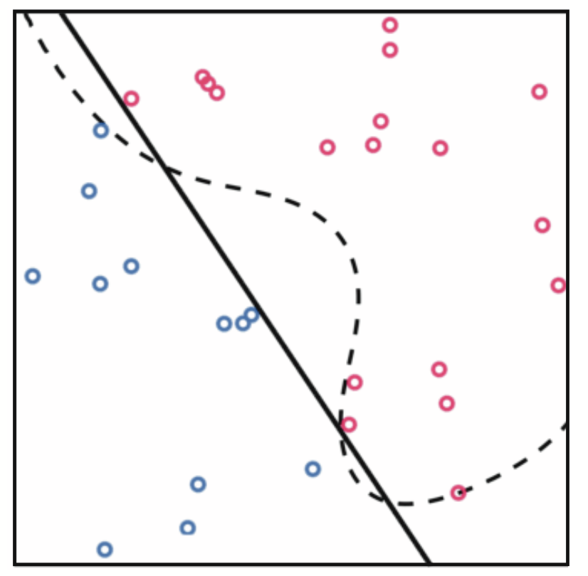
When a dataset is too small.
When a dataset is too small to represent the true underlying phenomenon feature learning can inadvertently determine an incorrect nonlinearity.
dashed curve: true data-generating function
solid curve: learned function

Slide 4
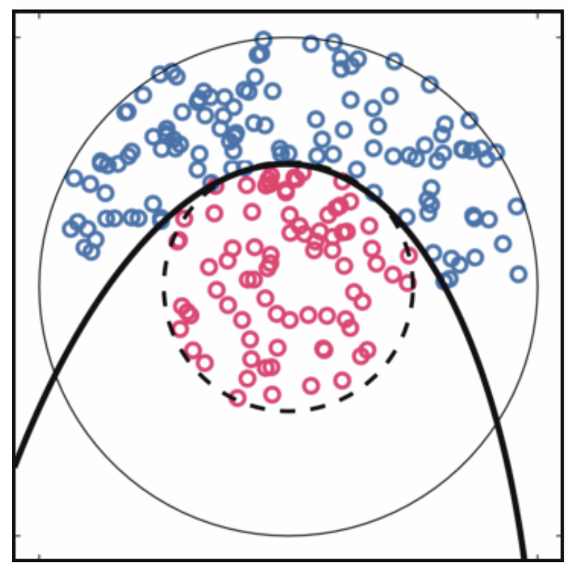
When a dataset is poorly distributed.
Even if a dataset is large it can still fail to reflect the true nature of the underlying phenomenon that generated it if the data is poorly distributed.
dashed curve: true data-generating function
solid curve: learned function

Slide 5
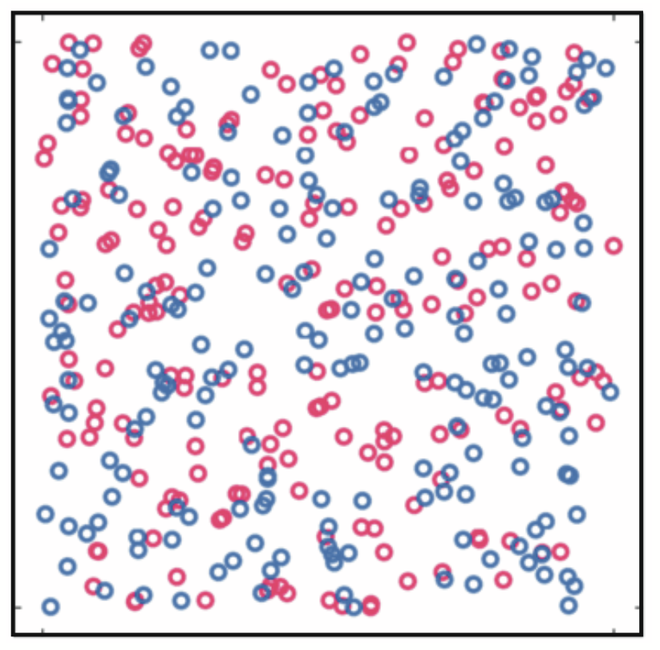
When a dataset has no inherent structure.
If there is little or no relation- ship present in the data (due to improper measurement, experimentation, or selection of inputs) the nonlinear model learned via feature learning will be useless.

